Slide 1
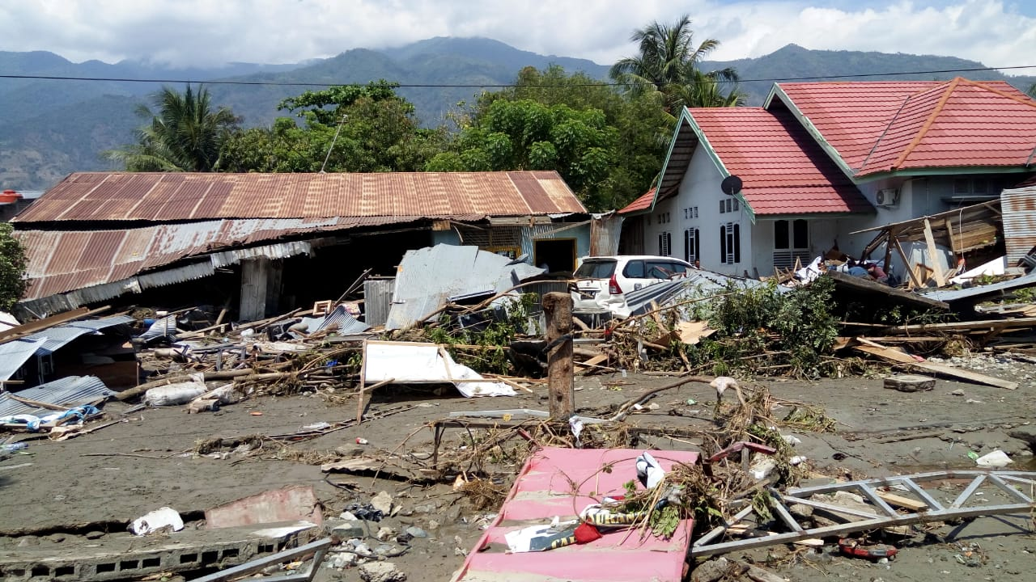
Central & South Pacific Plates
By: Lia, Rosa, Oliva, Rashini, Tarunima
Group 5

Slide 2
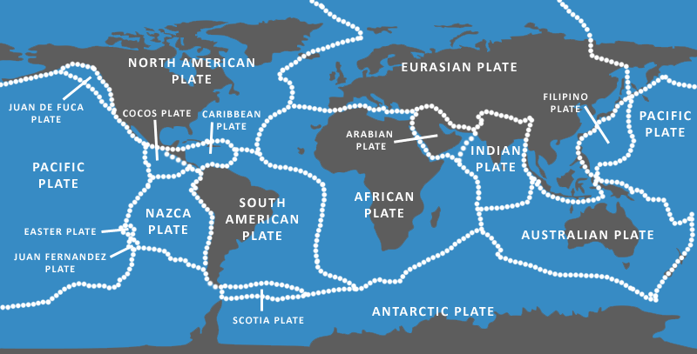
Region and Surrounding Plates:
Region: Pacific Plate
Neighboring Plates: Juan de Fuca, N. American Plate, Cocos, Nazca, Easter, Juan Fernandez, Antarctic, Filipino, and Australian Plate.

Slide 3
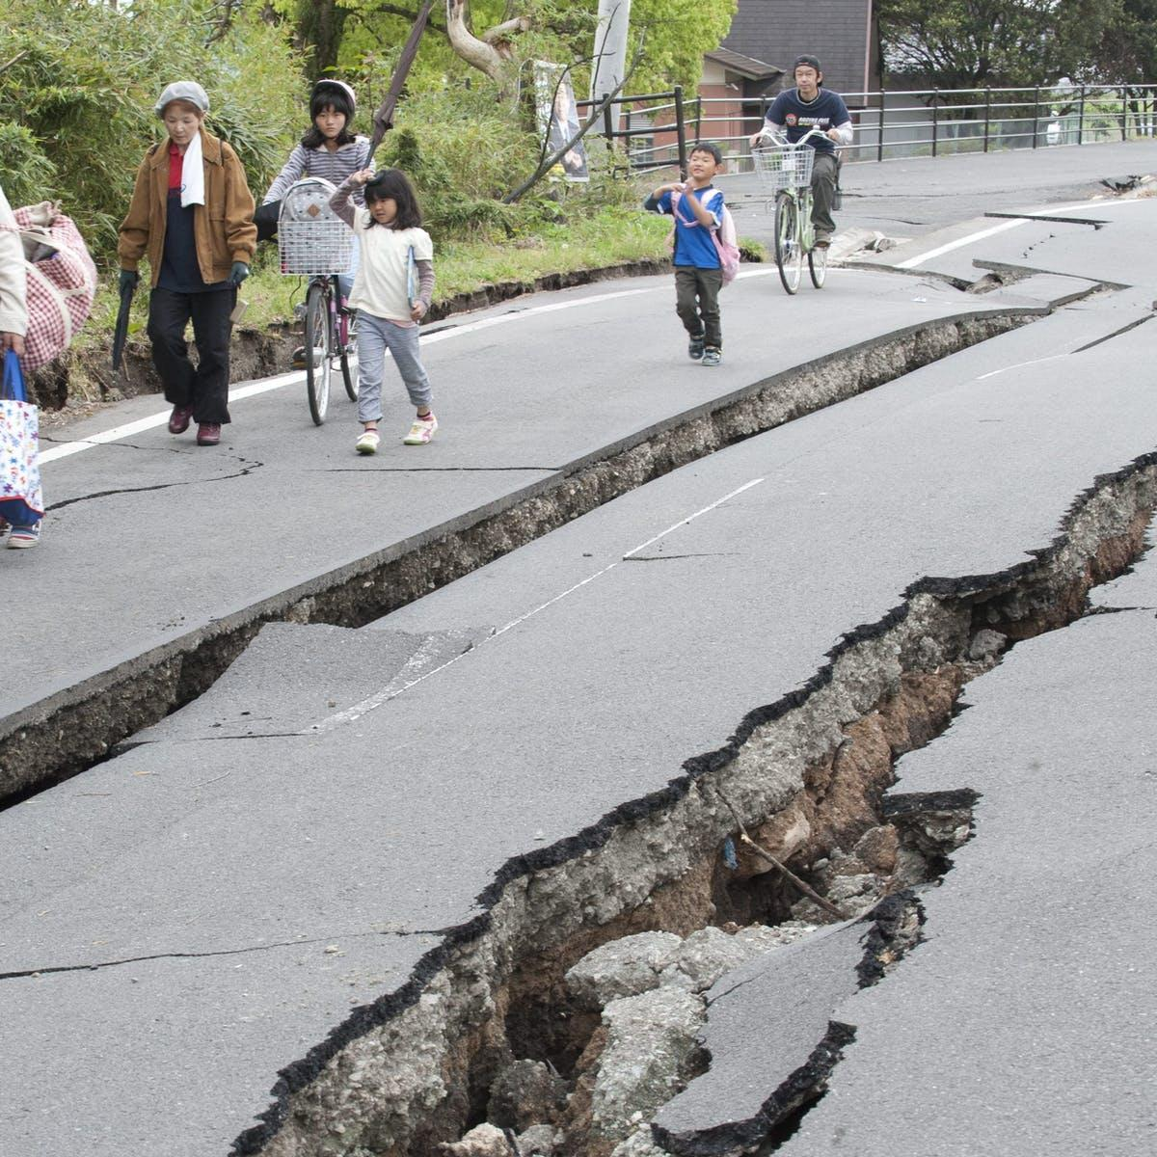
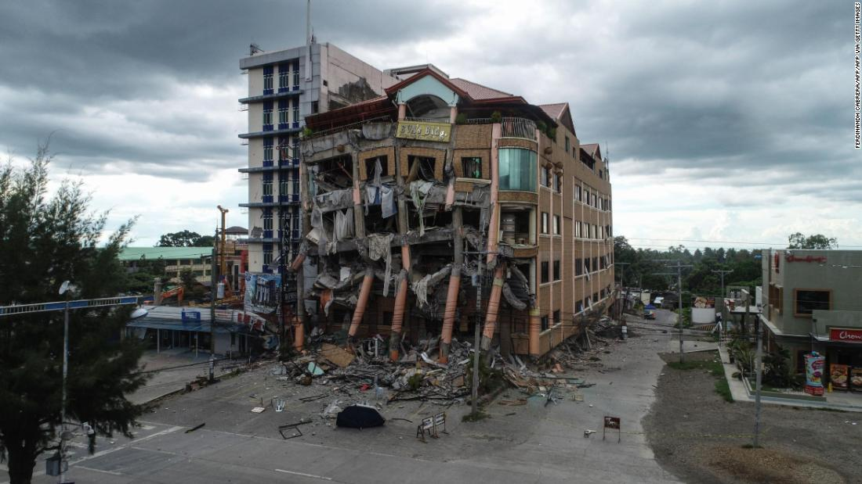
How common are earthquakes:
Earthquakes are extremely common between the Central and South Pacific plates. In fact, almost every year since the start of 1900, there has been at least one to three earthquakes yearly in this area. The impact of these earthquakes have been very harsh as the damage has ranged mainly from 6-8 on the Richter Scale.
Notes:
According to an Asian newspaper, about 100-150 earthquakes are felt yearly in the philippines, and 160 earthquakes yearly with a magnitude of 5 or higher in Japan. This is maily due to the fact that these countries lie in the ring of fire, a strongly effected area as the plates in these areas are constantly shifting. The impact of these plates is in turn felt by these countries and often have lasting impacts as infrastructure is damaged and many are injured.

Slide 4
Are there are notable major earthquakes:
In Indonesia, Sulawesi at Sep 28, 2018 the magnitude of 7.5 on the Richter Scale. 4340 people died and 667 missing.
On June 25, 1976, An earthquake with a magnitude of 7.1 resulted in 6000 deaths. This earthquake was located in New Guinea, Indonesia.
1976 Moro Gulf earthquake was 8 on the Richter Scale but only killed 1200.
Notes:
These are three of the major notable earthquakes, in the south pacific plates
#1 we have …

Slide 5
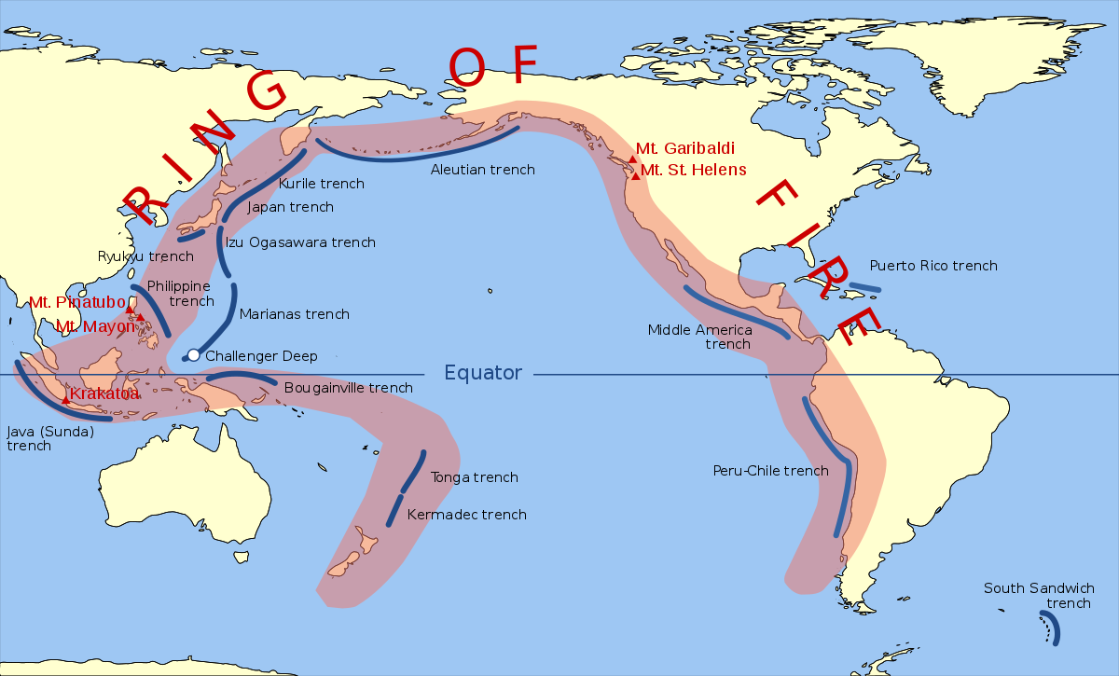
Interesting seismic activities:
Indonesia is prone to earthquakes as it lies in the“Ring of Fire”.
Frequency of earthquakes in regions has been rapidly increasing with similar magnitude types
A recent earthquake in Java, Indonesia, with a magnitude of 6.0 mw and intensity of V, left 9 fatal and 104 injured
Earthquake in Maluku indonesia with magnitude of 6.5 mw and intensity of VII, left 41 fatal and 1578 injured.
Notes:
Indonesia, is one of the countries that is prone to earthquakes, due to the fact that it lies on the so called “Ring of Fire”. The frequency of earthquakes in regions such as japan and indonesia have been rapidly increasing in the past periods. They all have similar magnitude types, ranging from “mb”, to “mww”.
A recent earthquake in Java, Indonesia, with a magnitude of 6.0 mw and intensity of V, left 9 fatal and 104 injured
An earthquake in Maluku indonesia, with a magnitude of 6.5 mw and intensity of VII, left 41 fatal and 1578 injured.

Slide 6
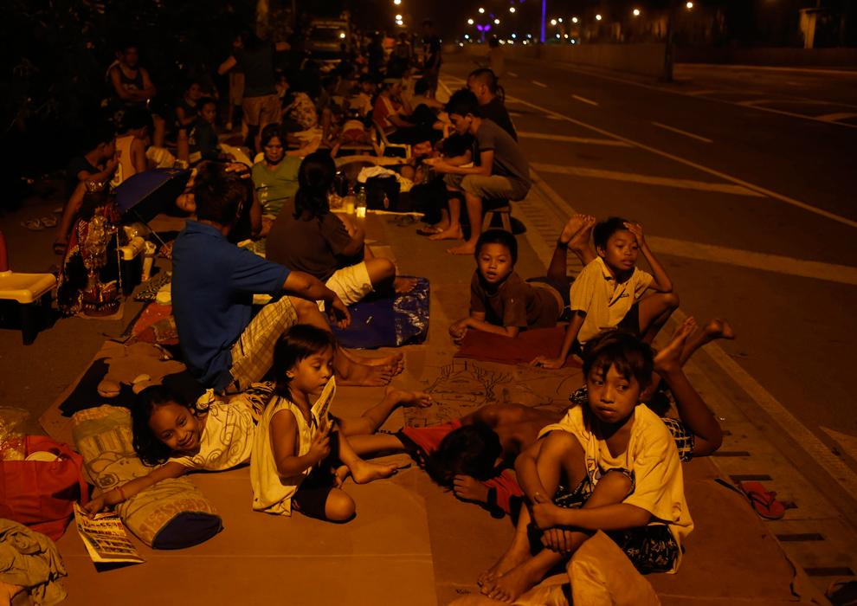
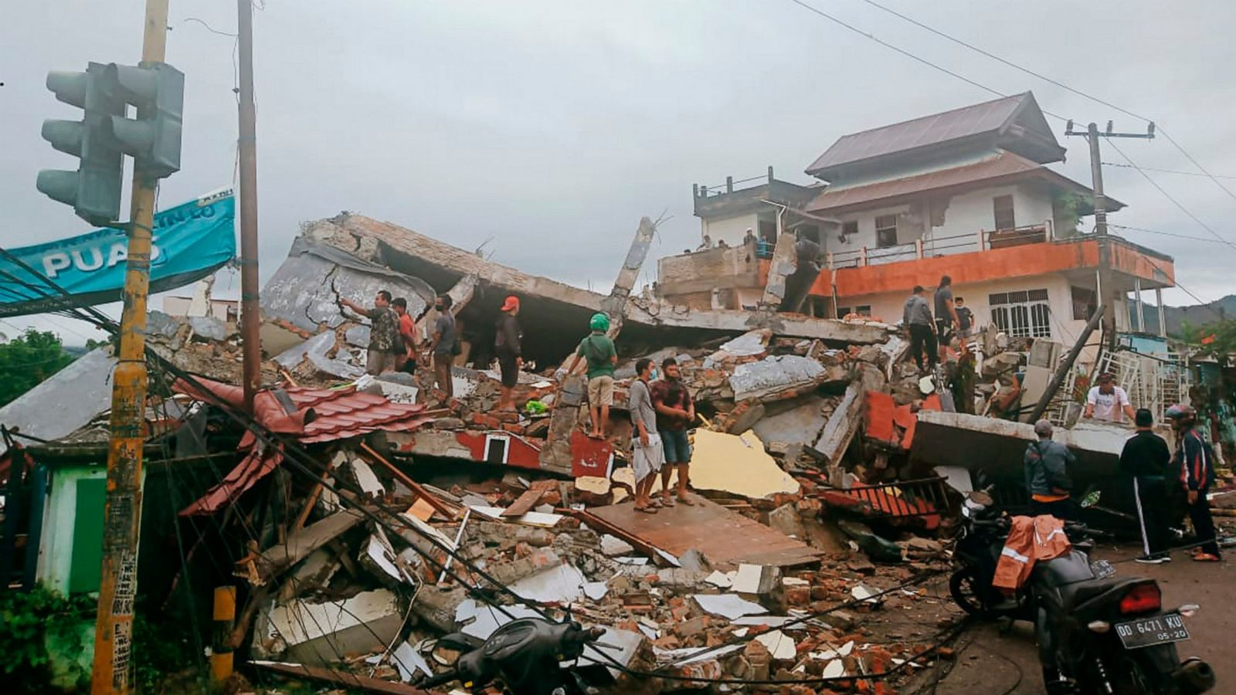
How prepared/able to rebuild are communities in our region:
Many of the affected communities lack resources
Communities have a large percentage of people below poverty line
Slower rebuilding
Notes:
Many of the affected communities in this region such as Indonesia and the Philippines lack basic resources and have a large percentage of people that are below the poverty line, therefore it takes longer to rebuild in these communities, but as these communities are frequently impacted, they have procedures in place.

Slide 7
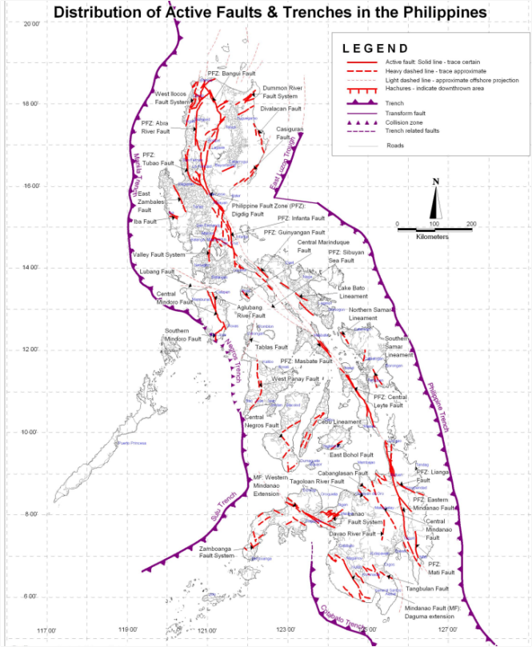
Are all the communities in your region affected equally?:
Not all the communities are affected equally as some are closer to the fault line than others which makes them more vulnerable to disasters.
As mentioned before, these countries are along the Ring of Fire which is where major tectonic plates meet very regularly
Notes:
Not all the communities are affected equally as some are closer to the fault line than others which makes them more vulnerable to disasters.
As mentioned before, these countries are along the Ring of Fire which is where major tectonic plates meet very regularly and causes frequent earthquakes

Slide 8
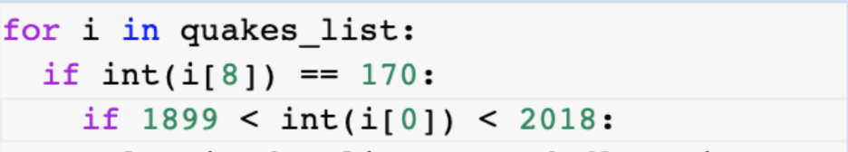
Specifying the data using code
Conditional statements using if → narrowed down data
First if statement → defined region
Region_code was 8 in the index
Comparison operator defined the region to Central and South Pacific using its region code
Second if statement → defined time range
Year was 0 in the index
Comparison operators limited the years to 1900-2017
Notes:
We used a “for loop” and the conditional statement “if” in order to narrow down the data within the list . Using the index, we defined our region with the first “if” statement. Region_code was 8 in the index, and we used the equal to comparison operator to define it as 170. 170 is the region code for the Central and South Paciific. We used the index again for our second “if” statement in order to narrow down the time range. Year was 0 in the index and we used greater and less than comparison operators to limit the range to 1900 to 2017.

Slide 9
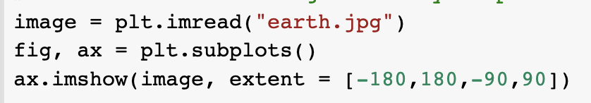

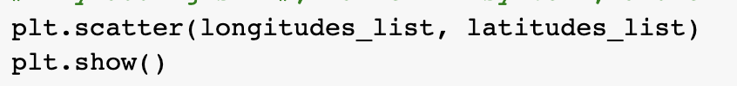
Making Graphs with Code
The “earth.jpg” in the first line gives us the image behind the scatter plot in our graph.
These lines crops our entire jpg image to show only the area we are working on, the central and south pacific plates area. They match our region using the exact coordinates of where the area lies.
These lines added the points for the scatter plot, and the plt.show displayed these points.
Notes:
The coordinates for the data are in the longitudes and latitudes list. Since we utilized the matplotlib library, we use an additional plt in the beginning of certain lines. For example, in the beginning of the scatter plot line, we used plt.scatter to create a scatter plot in our jupyter notebook.

Slide 10
Project Goals
Use the intro to python to successfully run code and make the entire project easier by making our code do all the work for us.
Successfully attempt as a group to work through coding errors and learn from our mistakes.
Learn about how earthquakes affect the central and south pacific plates.

Slide 11
Challenges/Solutions
Challenge: getting the code to run
Solution: asking Carol and the jr. TA’s to assist us. Additionally, working as a team to help work through difficulties and errors.
Challenge: finishing on time
Solution: we split the work and got through it much faster. Although we are new to working with each other, we didnt exactly get all the slides we wanted to include. Next time, we will use our time more efficiently and add more in depth slides to convey our points in our presentation.

Slide 12
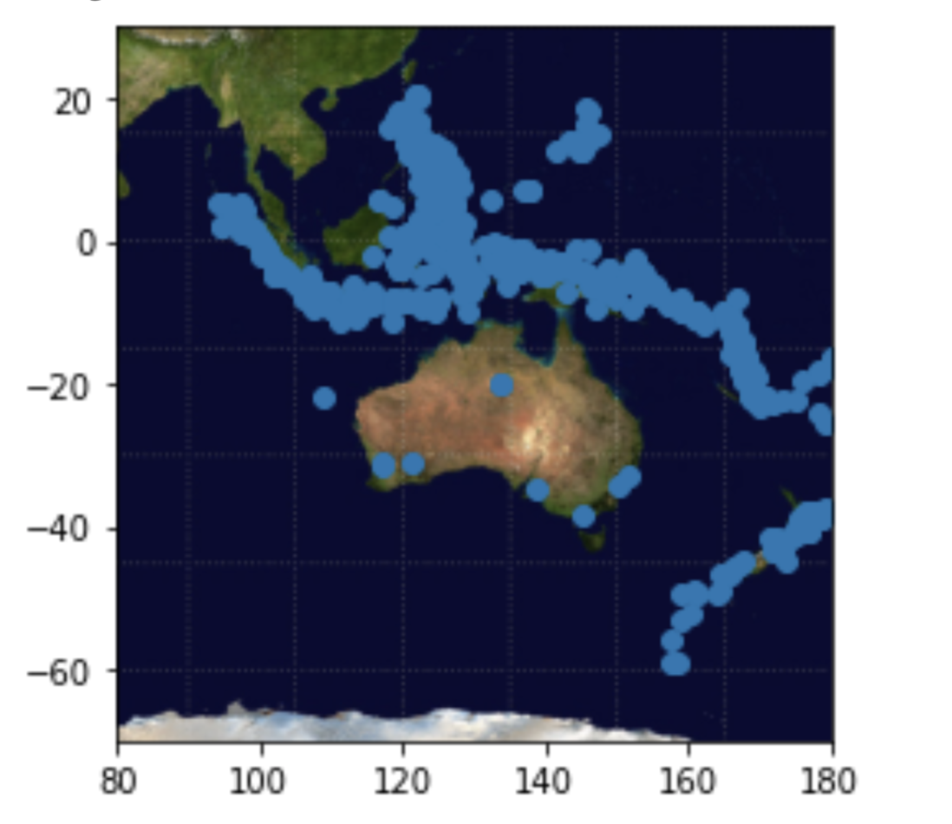
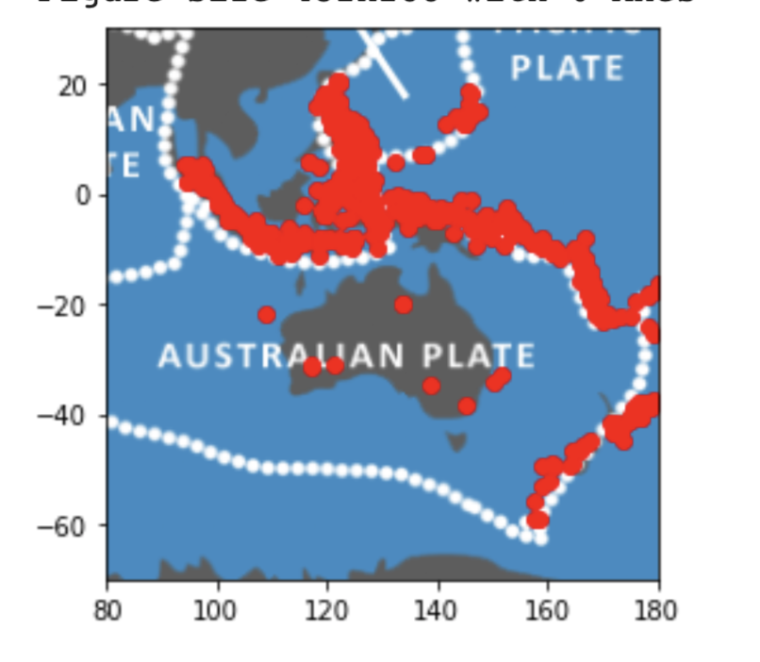
Graphs
Notes:
These are the scatter plots we made using code. The coordinates are made up of the data in our longitudes and latitudes lists and show where earthquakes took place. The graph on the left is displayed over a map of earth (specifically the central and south pacific). The graph on the right shows where earthquakes occurred along the tectonic plate boundaries.

Slide 13

